Slide 1
Memulai Karir IT Dengan Kontribusi Tanpa Nanti
Open Talk WRI Polinema 2018

Slide 2
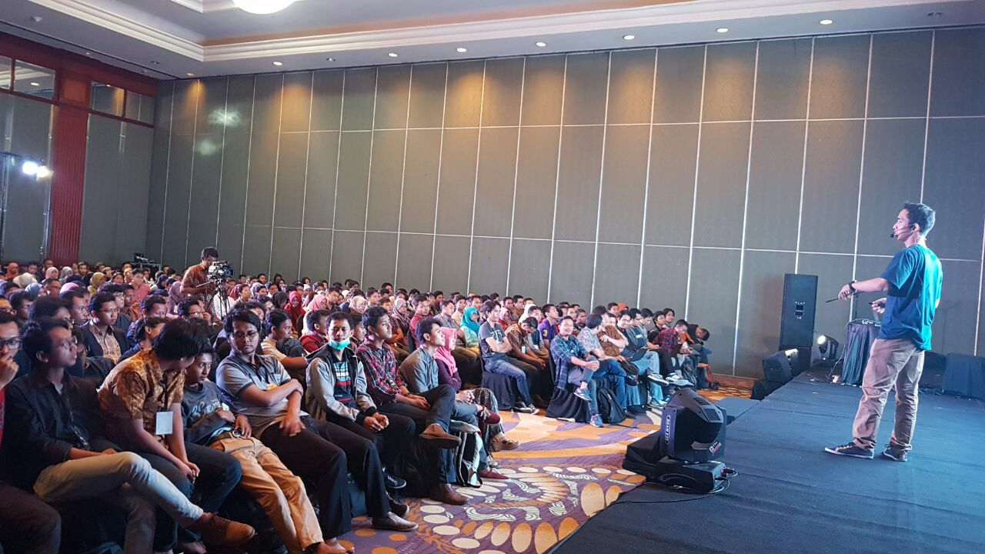
MUHAMMAD NAUFAL RABBANI
Frontend Engineer @ Teleolabs, Pte. Ltd. Singapore
Frontend Engineer @ PT. Codemi Indonesia
Mahasiswa UINSA Surabaya
Sidoarjo, 25 April 1997

Slide 3
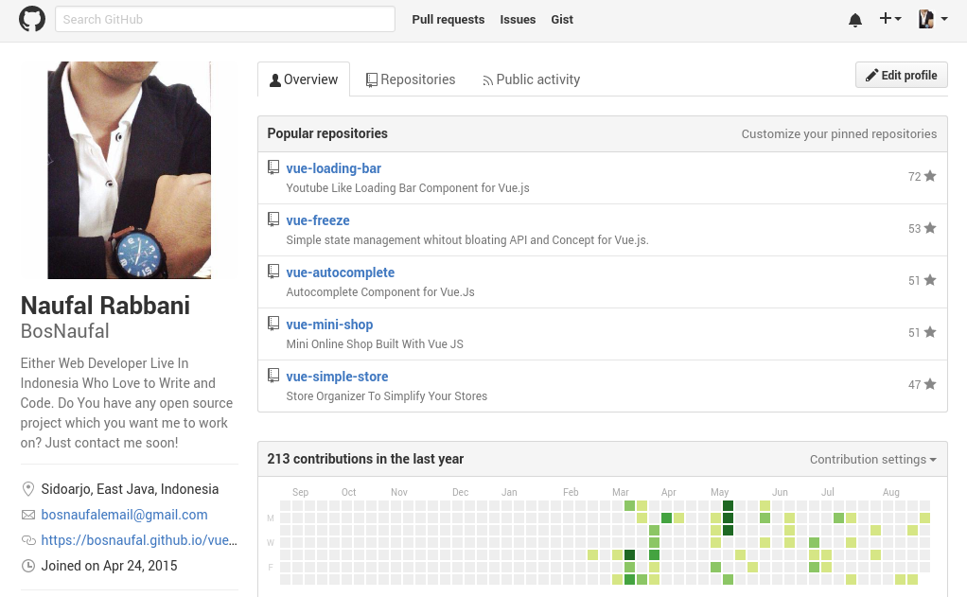
github.com/BosNaufal

Slide 4
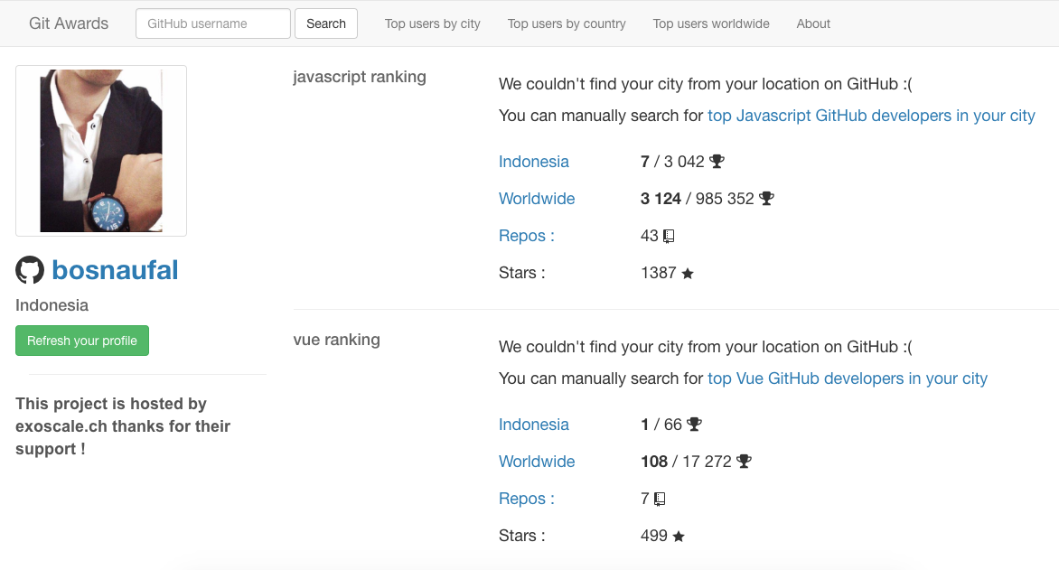

Slide 5
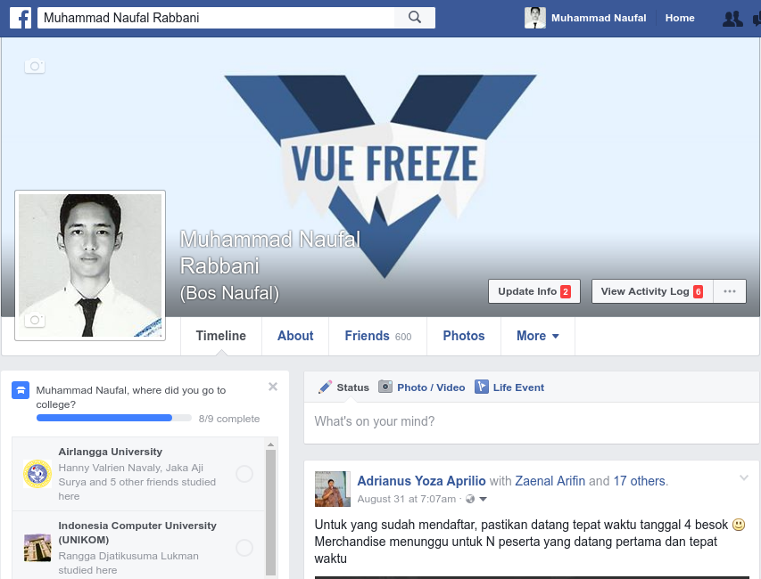
facebook.com/BosNaufalAccount

Slide 6
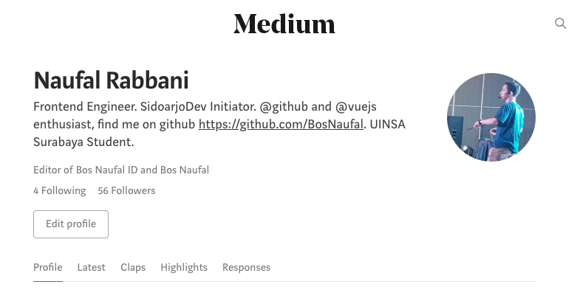
medium.com/@BosNaufal

Slide 7
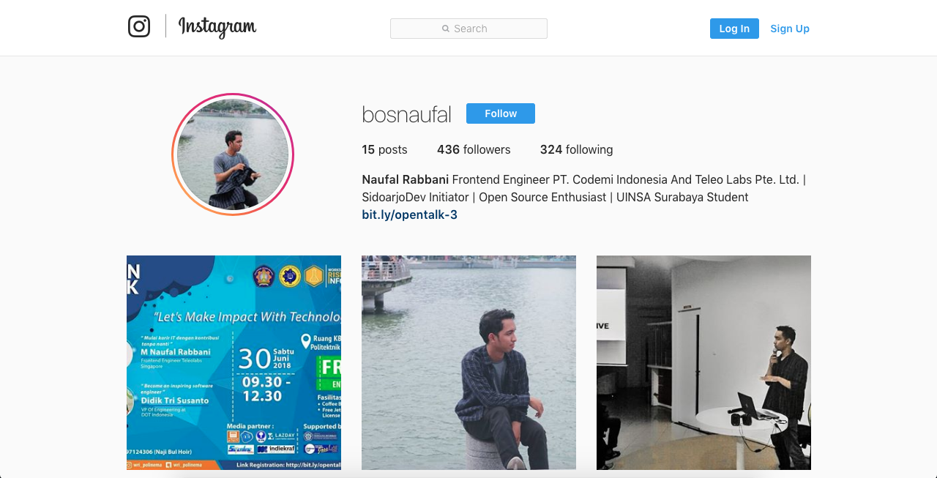
instagram.com/BosNaufal

Slide 8
Kenapa kita harus mulai berkarir di industri IT?

Slide 9
Kenapa kita harus mulai berkarir di industri IT?
Pangsa Pasar Besar
Banyak Startup Bermunculan
Fleksibel
Tak perlu banyak modal

Slide 10
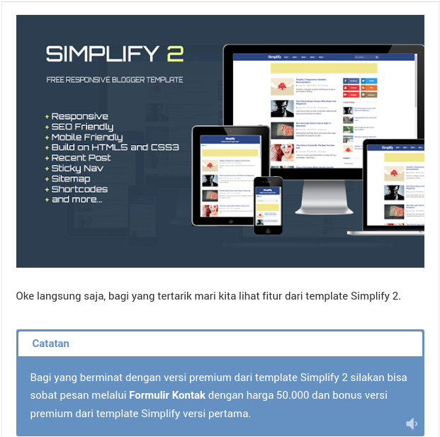

Slide 11
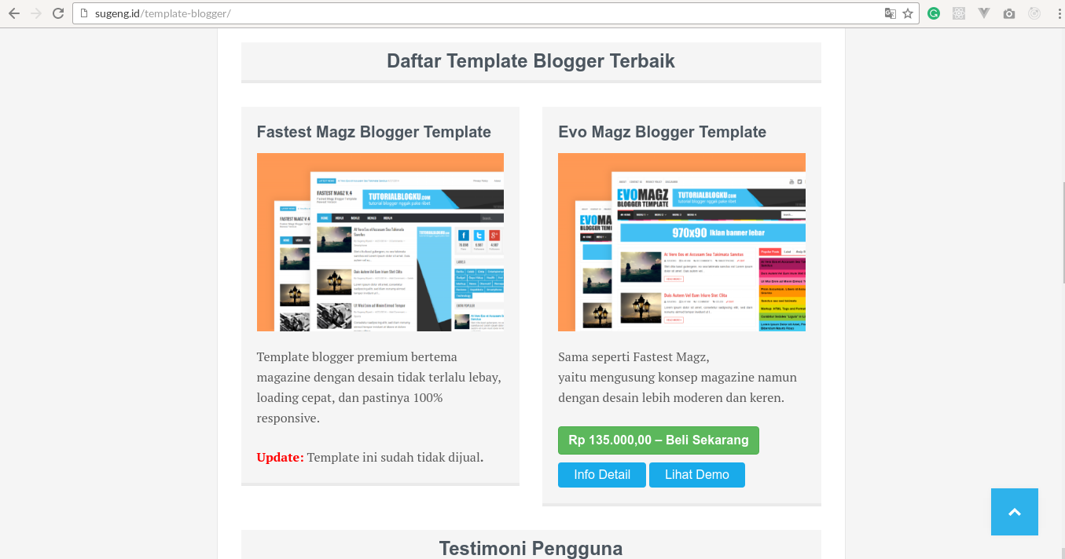

Slide 12
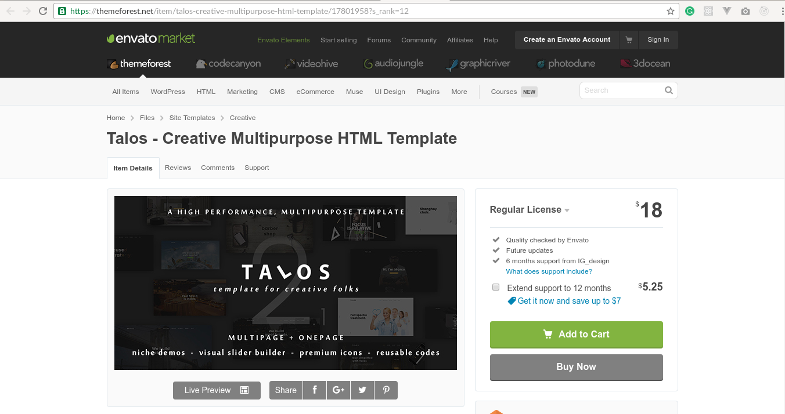

Slide 13
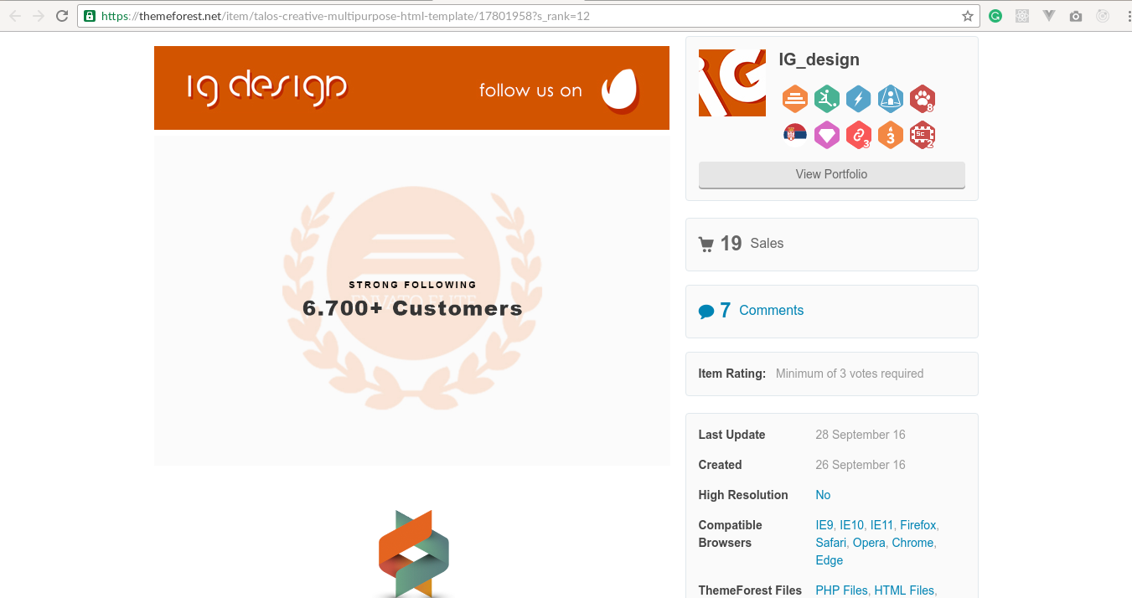
Notes:
Diambil 1 Oktober

Slide 14
18$ x 19 Sales x 10,000 = 3,420,000
26 September - 1 Oktober = 5 Hari

Slide 15
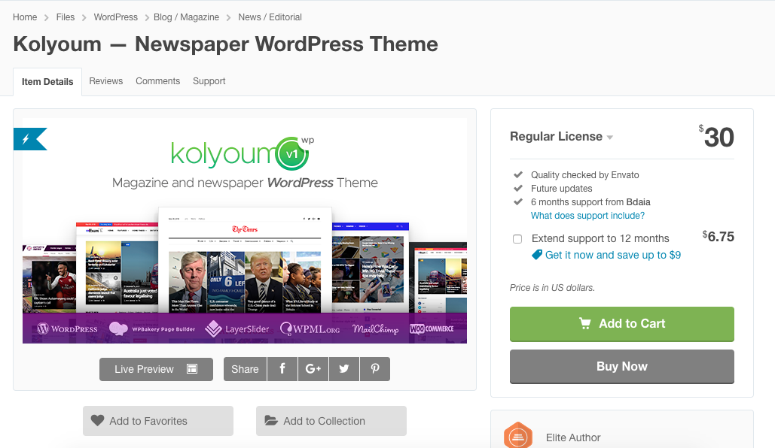

Slide 16
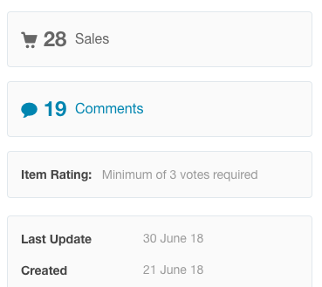

Slide 17
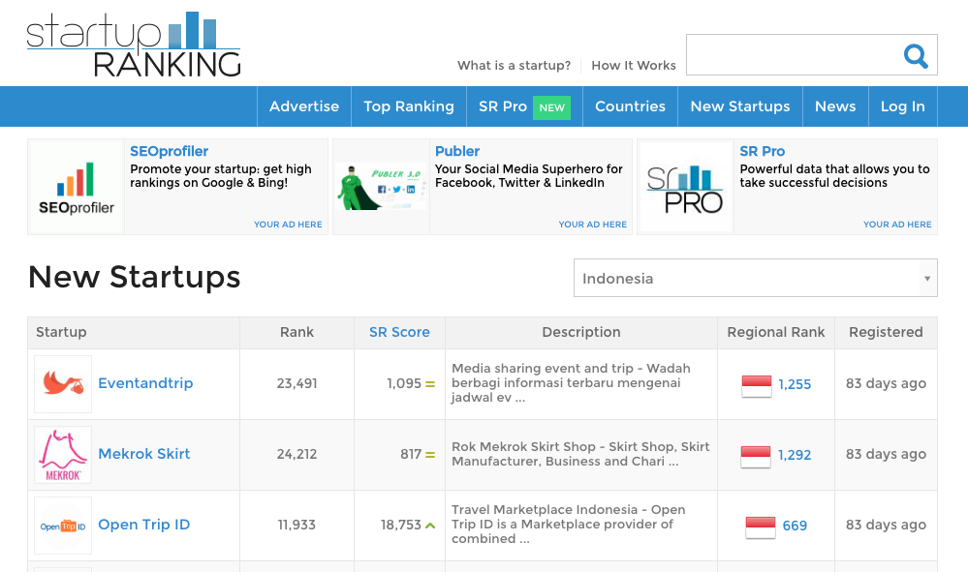

Slide 18
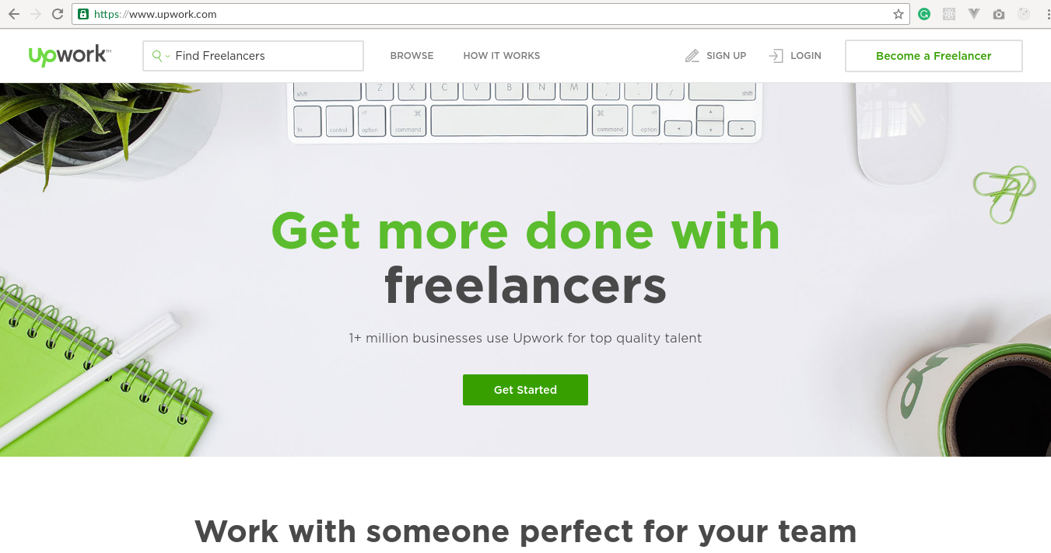

Slide 19
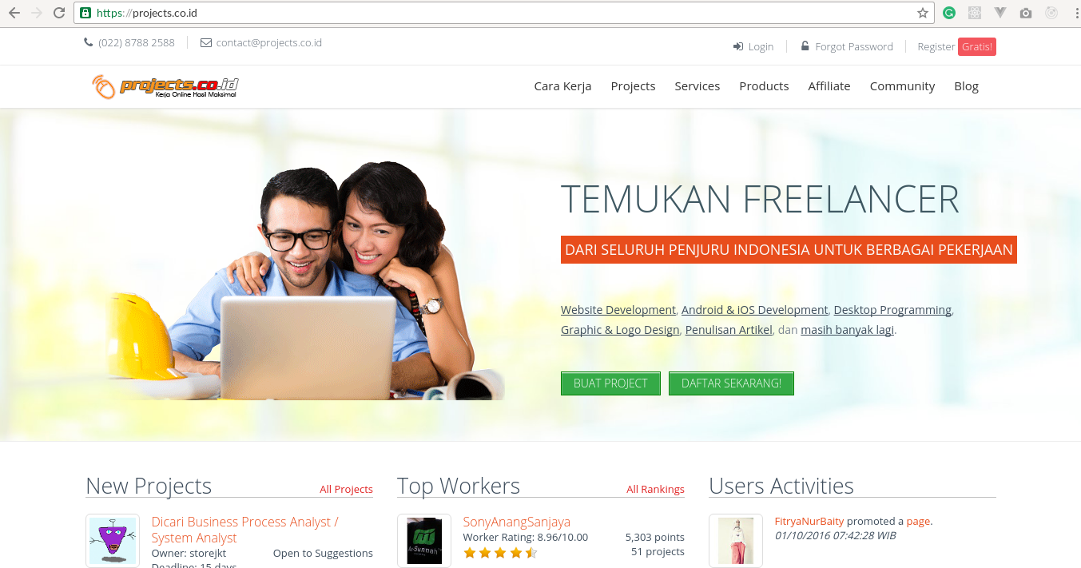

Slide 20
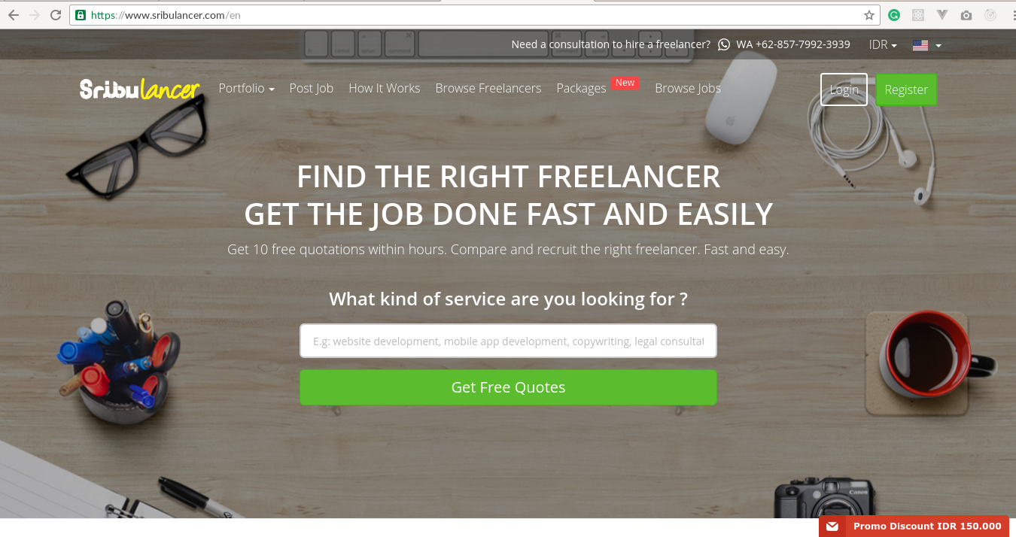

Slide 21
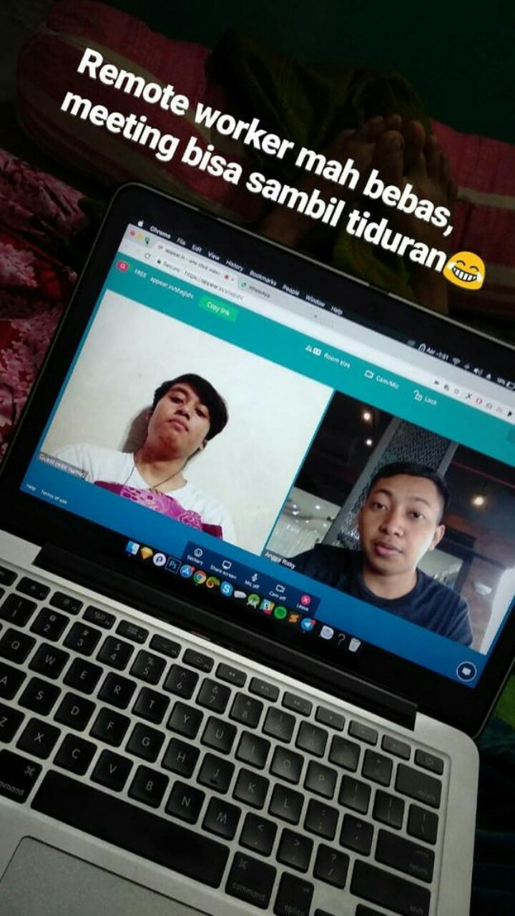
@fahmyhaa

Slide 22


Slide 23


Slide 24
Bagaimana cara memulai karir di industri IT?

Slide 25

Mulailah dengan kontribusi

Slide 26
“Kalau emas dinilai dari karatnya, Manusia dinilai dari manfaatnya”
-- Ippho Santosa

Slide 27
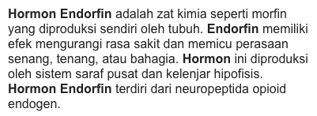
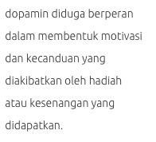
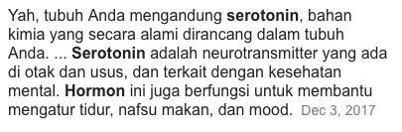

Slide 28
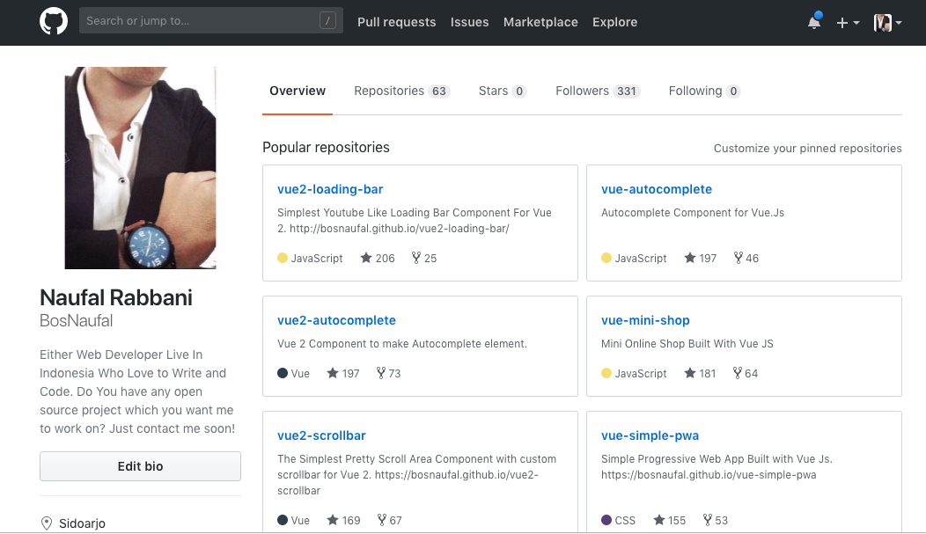

Slide 29
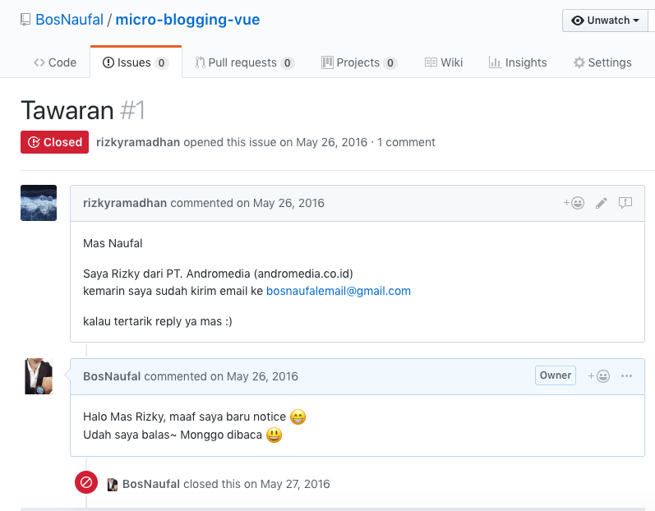

Slide 30
Pengalaman Kerja
PT. Andromedia
Surabaya as Frontend Engineer
May 2016 - Feb 2018

Slide 31
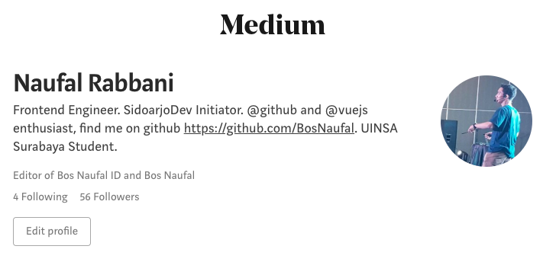

Slide 32
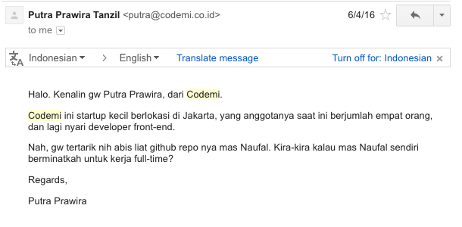

Slide 33
Pengalaman Kerja
PT. Andromedia
Surabaya as Frontend Engineer
May 2016 - Feb 2018
PT. Codemi Indonesia
Jakarta as Frontend Engineer
Dec 2016 - Present

Slide 34
As a speaker at...
SurabayaDev Meetup
How to make online shop with Vue JS
MAGE ITS 2016
Progressive Web App
Google Developer Student Club
Progressive Web App
Bekraf Developer Day 2016
Progressive Web App, Progressive Skills
SidoarjoDev
Initiation
How to make a website with bootstrap
F8 Developer Circles Surabaya From Facebook
Styling in React

Slide 35
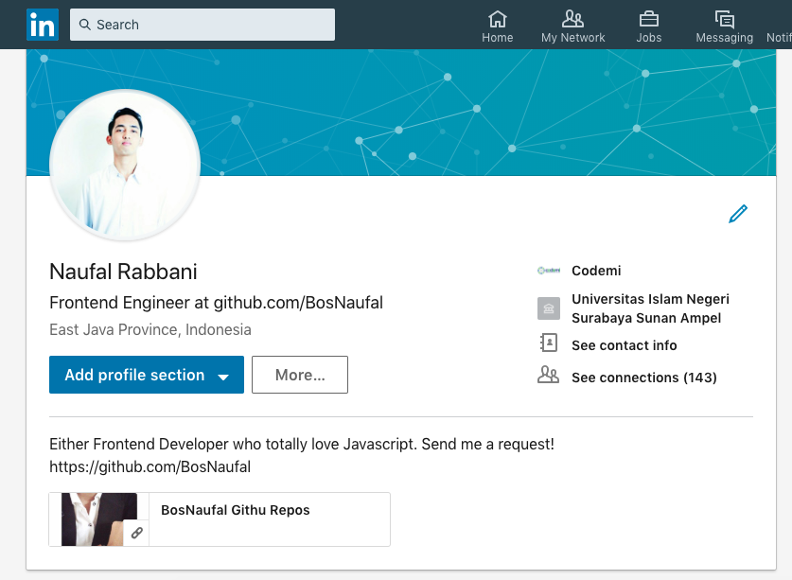

Slide 36
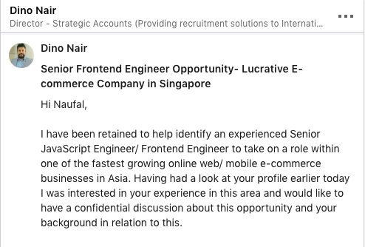
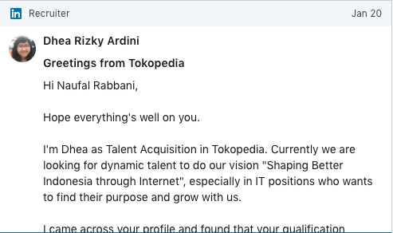
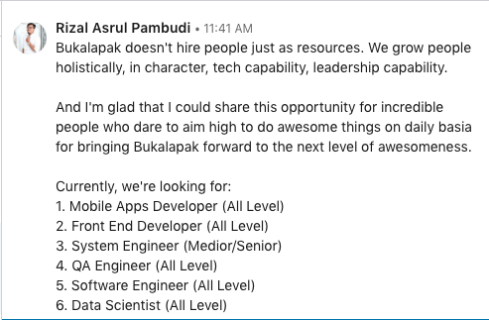
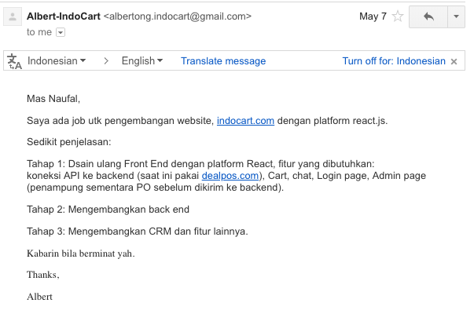
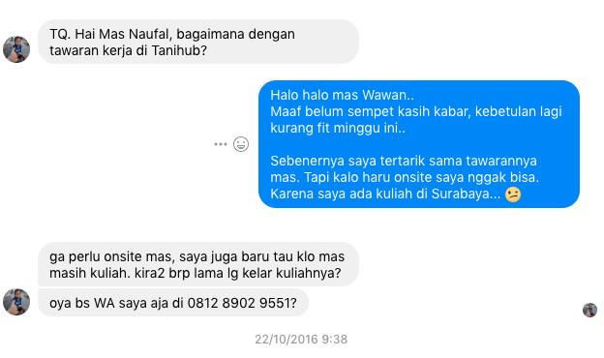
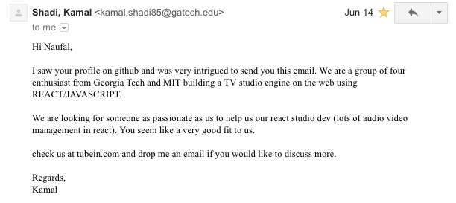
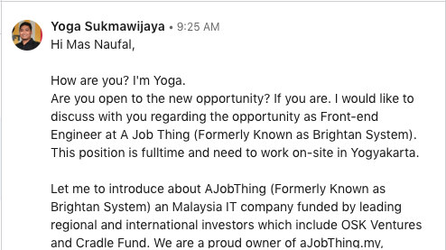
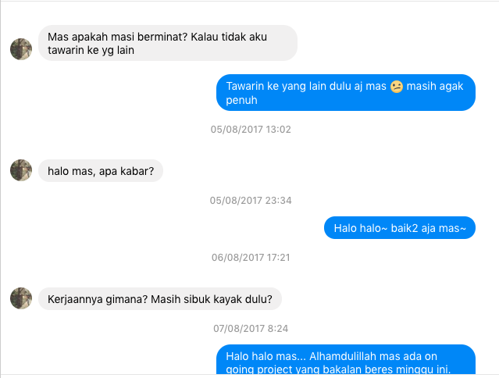
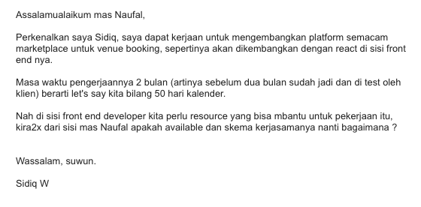
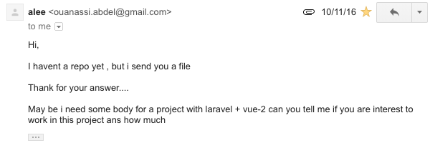
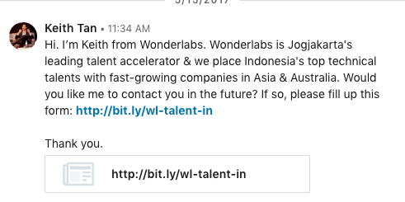

Slide 37


Slide 38
Pengalaman Kerja
PT. Andromedia
Surabaya as Frontend Engineer
May 2016 - Feb 2018
Teleolabs Pte. Ltd.
Singapore as Frontend Engineer
Feb 2018 - Present
PT. Codemi Indonesia
Jakarta as Frontend Engineer
Dec 2016 - Present

Slide 39
Lakukan dengan benar...

Slide 40

TATA NIAT
Untuk Awal, Jangan Terlalu Fokus Pada Uang

Slide 41

LEARN
Keep Up To Date, Keep Trying, And Keep Exploring

Slide 42

FOCUS
On What You Love & Be Specialist

Slide 43
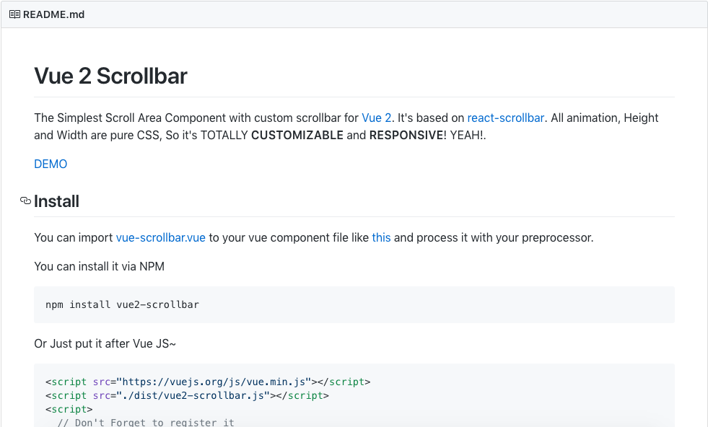

Slide 44
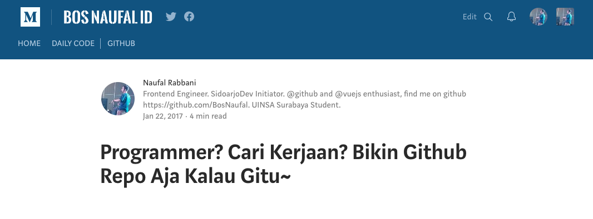

Slide 46
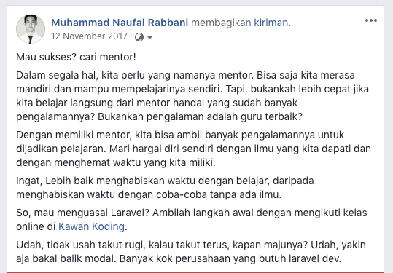

Slide 47




PERSONAL BRAND
Build Your Personal Brand

Slide 48
Join The Community
https://www.facebook.com/groups/surabayadev/
Perkuat “link”

Slide 49



SHARING
Berbagi dengan Sesama & Jadilah Bermanfaat

Slide 50
Kapan kita bisa memulai kontribusi?

Slide 51
TERIMA KASIH!
Sampai Jumpa Di Event-Event Berikutnya~

